Slide 1

FSH512: FALLING INTO A REALISTIC BLACK HOLE
By Udai Sharma (22261555)
UNDER THE SUPERVISION OF
DR BRIEN NOLAN

Slide 2

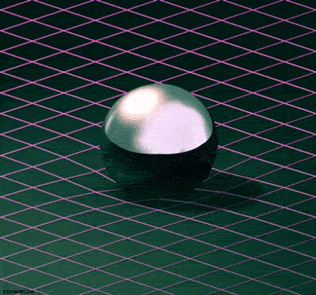
Introduction
Einstein’s published his theory of gravity in 1915 in the paper titled "The Field Equations of Gravitation”.
It provided a new understanding of the gravitational force as the curvature of spacetime caused by mass and energy.
Predicts the existence of black holes, gravitational waves and many other exotic phenomenon.

Slide 3
Project Overview
Do generic weak space-time singularities exist?
Schwarzschild Black hole?
Fate of an infalling observer in a Schwarzschild Black hole?
What is the effects on an observer falling into such a singularity?

Slide 4
Motivation
The study of black holes and singularity is motivated for the following reasons:
Even after strong evidence of the existence of space-time singularities that comes through observational and theoretical exploration, there is very little known about them.
Einstein’s equation breaks down and yields ambiguous results at the singularity, signalling the limitations of this theory.
The prevailing explanation for the origin of Universe comes from a point of singularity. Which makes it worth to understand the nature of singularities.

Slide 5
The basis of Science lies in the recognition of flaws in a current theory and work towards a more complete theory, It can be understood that the study of black holes and singularities provide us with an opportunity to uncover a new layer of reality.
??????
Einstein’s Theory of Gravity
Newtonian
Gravity

Slide 6
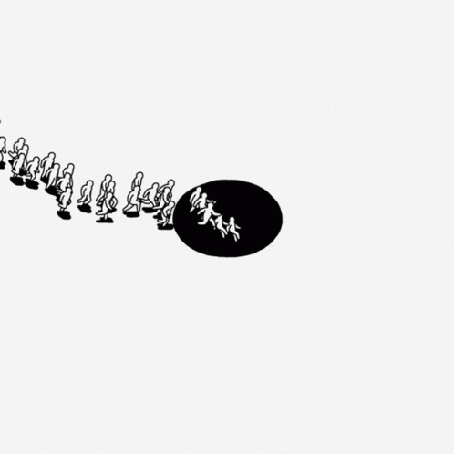
State of the Art in Singularity Research
The exploration of space-time singularities and black holes stands at the forefront of theoretical physics and cosmology.
These captivating phenomena, arising from the curvature of space and time predicted by Einstein's theory of general relativity, have captured the attention of researchers for decades.
**Researchers falling into the rabbit hole of singularity research**

Slide 7
Prior Studies
This study uses Tipler’s terminology for the gravitational strength of a singularity. The strength refers to the magnitude of physical quantities near the singularity and determines the severity of the breakdown of our current understanding of physics.
Balinsky-Khalatnikov-Lifshitz (BKL) Singularity has been widely believed to be an archetype for a realistic singularity.
Some studies have indicated the existence of a null and weak space-time singularity in context of a realistic black hole.
The BKL Singularity is a strong and space-like singularity and is the only known type of generic singularity,
However, it still lacks a rigorous mathematical backbone to firm it’s stand as the final state of a realistic gravitational collapse. Not even a single inhomogeneous singular vacuum solution of BKL type singularity has been proved.
1. Mass Inflation model: Kerr black hole background is approximated by the spherically symmetric Reissner-Nordstrom solution, and the gravitational perturbations are described using two cross-flowing null fluids
2. Nonlinear perturbation analysis of the internal structure of rotating black holes
Weak Singularity: Spacetime can be extended smoothly beyond the singularity point. Metric tensor remains continuous and well behaved.
Strong Singularity: physical quantities blow up and the smooth extension of spacetime is not possible, and the metric tensor becomes singular or degenerate.

Slide 8
Literature Gap
Despite extensive research in the field, the discussion about the structure and characteristics of generic and realistic singularities continues.
There have been several arguments in order to understand the nature of generic space-time singularities.
Null and Weak
Curvature
Singularity
Non-Linear nature of Einstein Equations
However, there is still a need for a rigorous mathematical analysis to show that a null and weak curvature singularity is consistent with the Field equations of Einstein’s theory of Relativity.
Strong and
Space-like
Curvature
Singularity?

Slide 9
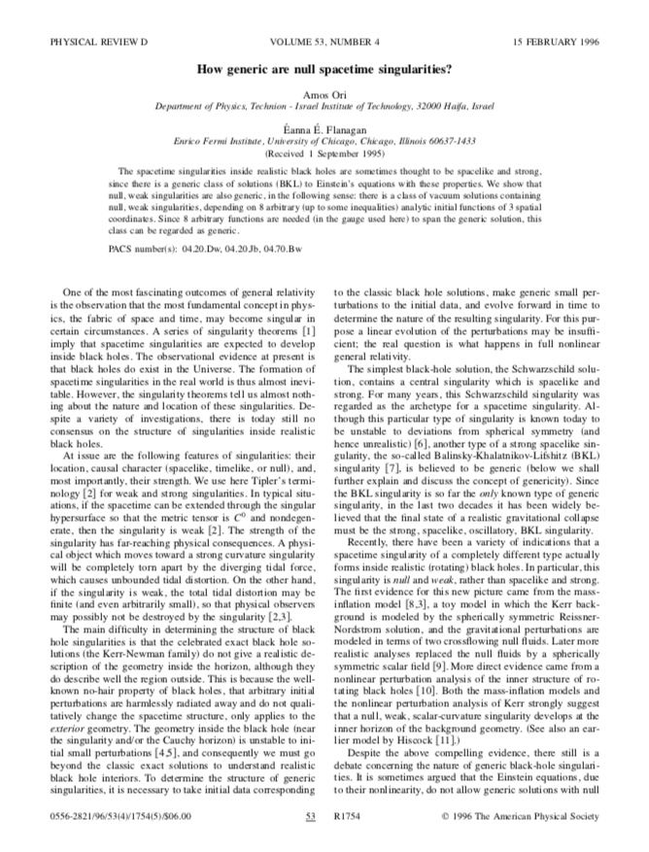
Ori and Flanagan have addressed this issue and introduced a mathematical approach in their paper titled “ How generic are null space-time singularities? “ suggesting that a weak singularity can be consistent with Einstein field equations. This can be determined by using the evolution equations on some initial data. Nevertheless, the detailed mathematical analysis supporting these claims has not been published. This study provides an in-depth analysis of the mathematical framework proposed by Ori and Flanagan and fills in the mathematical claims used by them.

Slide 10
Research Questions
Existence of Null and Weak Space-time Singularity
Schwarzschild
Black Hole
Schwarzschild
Singularity
Falling into a Realistic/Generic Singularity
What is the fate of an extended body as it moves along a timelike geodesic that falls into a Schwarzschild black hole?
What is the nature of the singularity that lies at the centre of the Schwarzschild black hole?
What is the fate of an extended body as it moves along a timelike geodesic and falls into a null and weak space-time singularity?
Can Einstein’s equations yield a generic class of solutions that admit a null and weak space-time singularity?

Slide 11
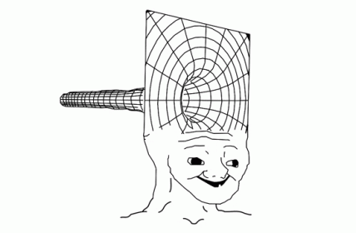
Methodology & Research Approach
This section is comprised of two segments
Schwarzschild Black hole: In this section, we discuss the mathematical framework that describes the fate of an observer falling into a Schwarzschild black hole and find out the nature of singularity that lies inside.
Null and weak singularity: In this section, we discuss the mathematical framework used by Ori and Flanagan to showcase that Einstein field equations admit a generic class of vacuum solutions containing a weak singularity. Furthermore, we also determine the behavior of Jacobi field as it falls into such a singularity in a 2-Dimensional case.

Slide 12
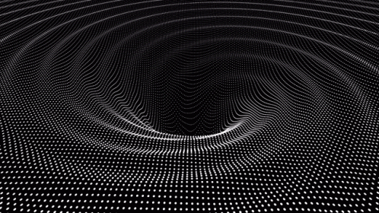
Schwarzschild Black Hole

Slide 13

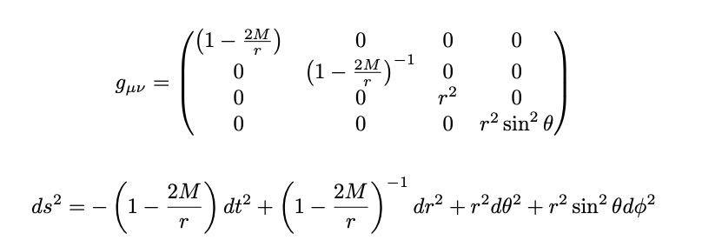
What do we mean by Schwarzschild Black hole?
Karl Schwarzschild provided the first exact solution to Einstein's field equations in 1916.
The Schwarzschild solution describes the presence of a black hole, named the Schwarzschild black hole.
It represents the simplest form of a spherically symmetric, non-rotating black hole, devoid of angular momentum and charge.
We work within a 4-dimensional spacetime, utilizing the spherical coordinate system :
The metric tensor and spacetime interval describing the geometry outside a Schwarzschild black hole take the forms :

Slide 14
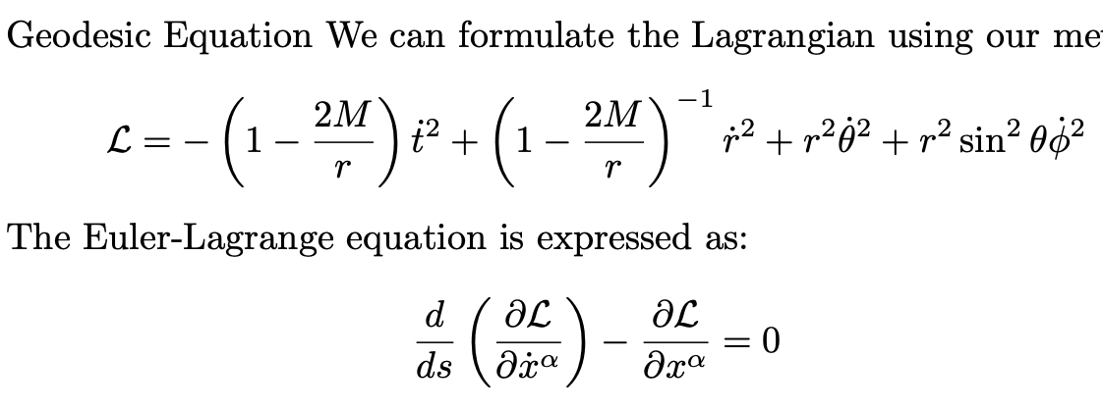
Formulating the Geodesic Equation
Lagrangian and the Euler-lagrange Equations:
We use the following facts which help us simplify our Lagrange Euler Equations and the Lagrangian.
The spherical symmetry allows us to work in the equatorial plane and fix θ = π/2, resulting in θ ’ = 0.
For radial geodesics, the angular momentum vanishes and so does ϕ ‘.
For a timelike geodesic, the Lagrangian can be set to −1.
Using the simplifications above, we obtain the following set of geodesic equations:
t ‘ = E / f
( r ‘ ) ² = E² - f
θ ’ = ϕ ‘ = 0

Slide 15
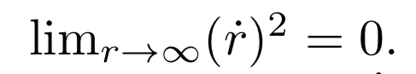

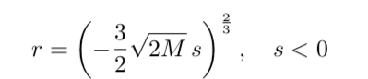
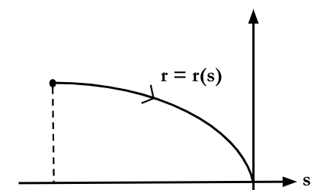
Considering the observer starts from infinity, where it is initially at rest, we can find the explicit form for ‘ r ‘ . As the observer is at rest, the expression .
Putting in the expression ( r ‘ ) ² = E²− f, we can conclude that E = 1. Hence, t ‘ = 1 / f
Noting that r decreases along the geodesic congruence, we get the expression:
Solving for ‘ r ‘ , we obtain the expression:

Slide 16
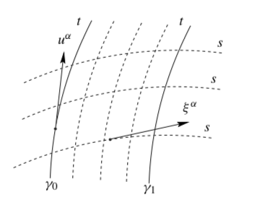
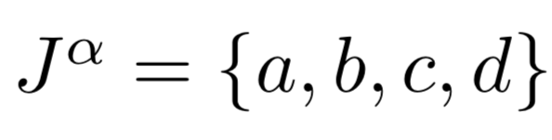
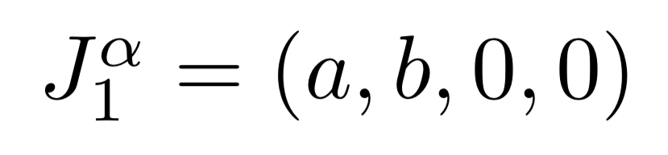
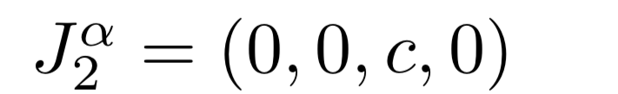
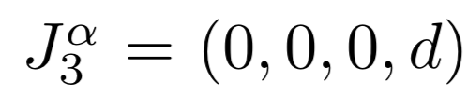
Formulation of Geodesic Deviation Equation
Geodesic deviation equation describes how the gravitational fields curvature influences the relative motion of nearby geodesics.
We consider the following form of Jacobi fields, which define the deviation vector in the above image,
Where, we decompose in the following:

Slide 17
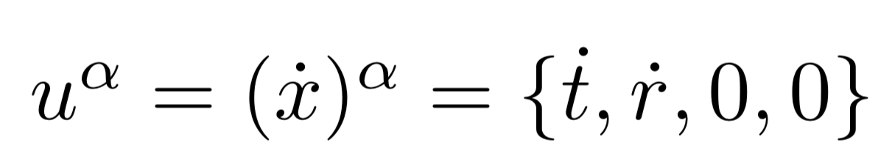
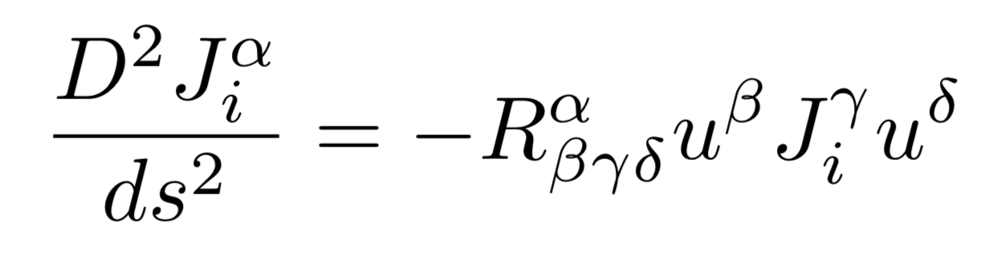
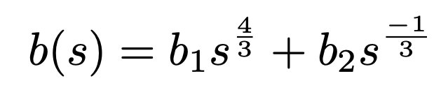
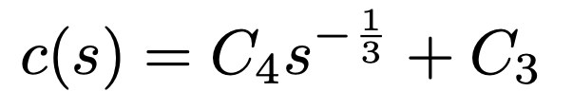
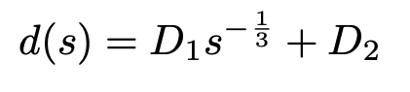
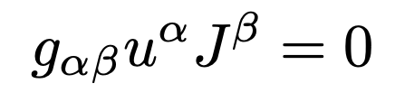
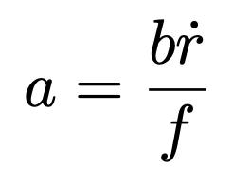
Our tangent vector along the geodesic is given by,
The geodesic deviation equation is given by,
The solution for the individual Jacobi field components have the form,
Further, we can find a(s) using b(s) by utilising the fact that the Jacobi fields are orthogonal to tangent vector.
Which gives the relation:

Slide 18
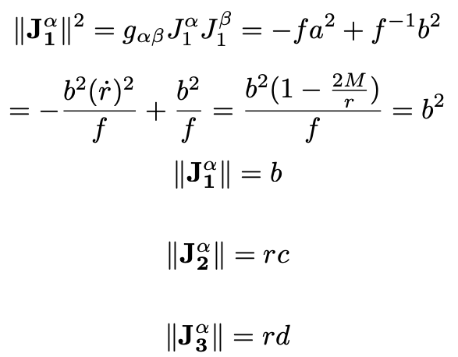
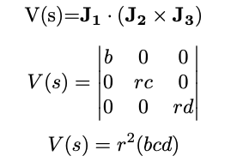
Magnitude of Individual Jacobi Fields
Similarly, we can calculate, and
We can also conclude that the individual magnitudes of the Jacobi field have the following feature:
As s 0 , Infinity, whereas, and Zero
However, The net volume covered by the Jacobi fields is calculated using,

Slide 19
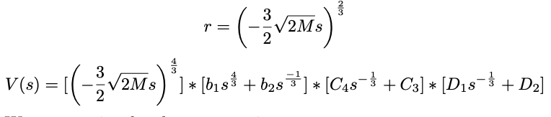
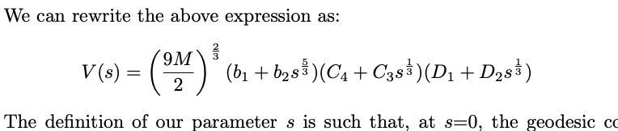
Using the expression for ‘ r ‘
We can rewrite the expression as,
The definition of our parameter ‘s’ is such that, at s=0, the geodesic congruence encounters a singularity. We can see that as s approaches zero, V(s) approaches zero. Hence, as we move along the congruence, the volume encompassed by the Jacobi fields tends to zero. For an observer falling into a black hole, we can conclude that an observer would be infinitely stretched along the radial direction and infinitely crushed along the tangential and azimuthal directions, resulting in Spaghettification of the observer. However, in totality the observer is destroyed completely to zero volume. Hence, calculating the volume of these Jacobi fields at s = 0 provides us a way to examine the nature of the singularity, Which in the case for Schwarzschild black hole is a strong and spacelike singularity.

Slide 20
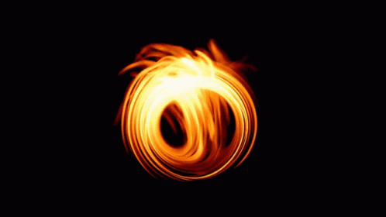
Realistic Black Hole

Slide 21
What do we mean by Realistic Black hole?
Initially, the Schwarzschild black hole was thought to be an archetype for a space-time singularity. However, it’s understood now that the Schwarzschild black hole is not an archetype for a realistic black hole as it lacks essential properties.
Spherical Symmetry
Non Rotating
Unstable to Perturbations
In reality most astrophysical objects possess some level of non-spherical structure. The assumption that the Schwarzchild black hole is spherically symmetric is an oversimplification
Most astrophysical objects, including stars and galaxies, possess angular momentum or rotation, which significantly affects their properties, such as the shape of the event horizon
Since it is unstable to deviations from spherical symmetry. This instability contradicts the nature of observed black holes which live in violent environments.
Realistic Black Hole
Realistic black holes typically exhibit long-term stability and complex behaviours such as accretion of matter, jet formation, and interactions with their surroundings, they essentially live in violent environments, and perturbations or disturbances to them are inevitable. Hence, A realistic black hole solution should be functionally generic, in the sense that it can adjust and reconfigure itself to accommodate minor perturbations.

Slide 22
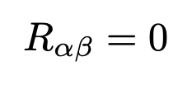
Mathematical framework: Initial Data
We start with the Einstein Field equation in vacuum:
Since, our Ricci tensor is a symmetric tensor, it has 10 independent components. Each component corresponds to a field equation.
These Einstein field equations are divided into a set of evolution equations and constraint equations.
Evolution Equations describe how the spacetime curvature or the metric tensor evolves over time. These equations involve double time derivatives of the metric tensor.
The constraint equations, on the other hand, are derived from the geometry of spacetime. These equations ensure that the solutions to the evolution equations are physically meaningful and consistent with the underlying geometry. These equations do not involve double time derivatives, but first order space, first order time, combination of space-time and second order space derivatives
We start by working in the coordinate system
= { u , v , x , y }

Slide 23
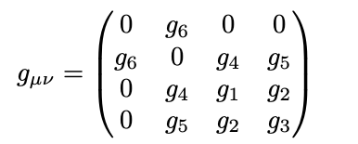
We adopt the gauge, g_{ux} = g_{uy} = g_{uu} = g_{vv} = 0
Our metric tensor takes up the form:
Where, g_{xx} = g₁ ; g_{xy} = g₂ ; g_{yy} = g₃ ; g_{yx} = g₄ ; g_{vy} = g₅ ; g_{uv} = g₆
Further, we determine the degrees of freedom ‘ K ‘, which is the number of initial functions required to uniquely determine the domain of dependance
For this, we introduce the variables,
T= v + u and Z = v - u
Using Cauchy-Kowalevski theorem at the hypersurface T=constant, we can say that there are 12 analytic functions namely g_{i} (x, y, z) and g_{i,t} (x, y, z), where i goes from 1 to 6. These functions need to satisfy the 4 constraint equations, Hence the number of degrees of freedom reduce to 8. This means, we need to specify 8 arbitrary analytic functions as part of the initial data to determine the domain of dependence.

Slide 24
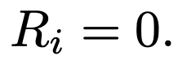
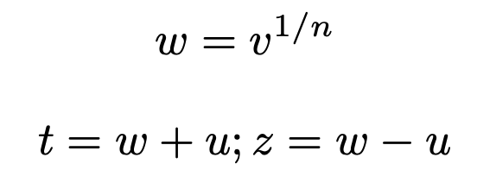
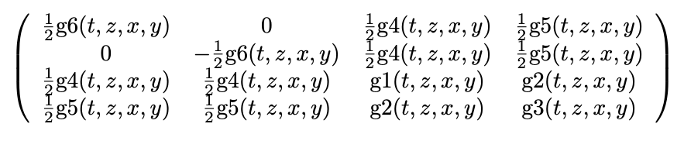
Mathematical Framework: Evolution Equations
Now, we focus our attention on the Evolution equations to determine the evolution of our initial data. There are a total of 6 evolution equations which correspond to
We start by defining the variables,
From here onwards, we use Wolfram Mathematica since our mathematical calculations take up rigorous forms.
We transform our independent variables from (u, v, x, y) to (t, z, x, y).
Our metric takes up the new form

Slide 25
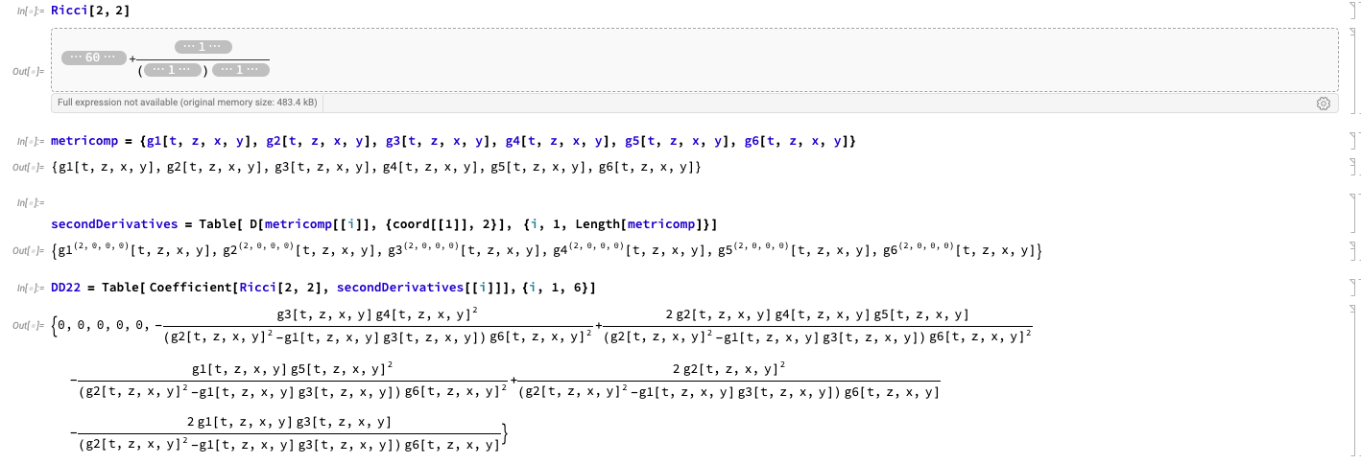
To understand the Field equations, we start working out with R₂₂.
We find that R₂₂ contains only second time derivatives of g₆. This motivates us to rewrite the equation in the form:
R₂₂ = A g_{6,tt} + B = 0, which can be further simplified.

Slide 26
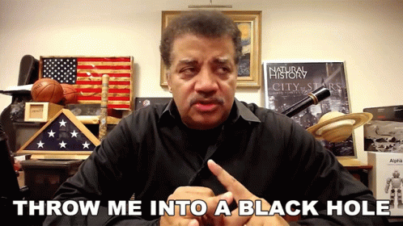
Finally, we can say that our Evolution equation for g₆ takes up the form :
g_{6,tt} = F_{i}( g_{j} , g_{j,t} , g_{j,A} , g_{j,AB} , g_{j,At} , z , t )
Where A,B run over the spatial variables and j runs from 1 to 6 corresponding to the metric components.
It is logical that the F_{i} will be a function of space-time and combinations of space-time derivatives except the second order time derivatives. Since, the field equations are second order equations.
This report encapsulates the formulation of this equation for a particular function g₆, but it is easy to find out that we can generalise this for rest of the metric evolution equations as well.
**Me at this point of the project**

Slide 27
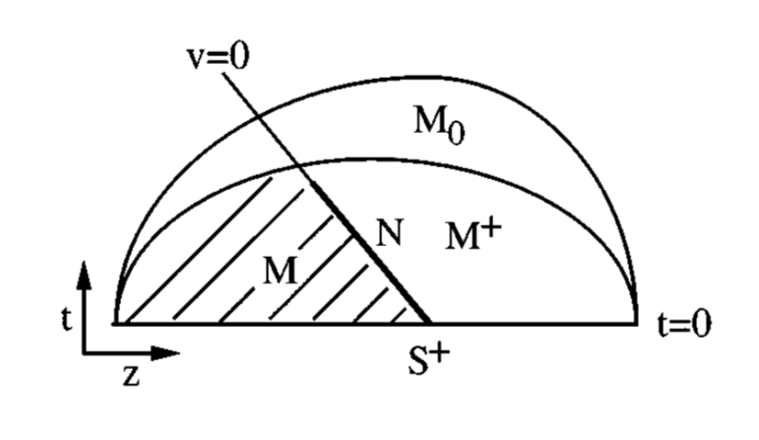
Mathematical Framework: Evolution of Initial Data
Consider an initial hypersurface t=0 and its intersection with the neighbourhood of origin represented by S⁺.
Let’s say M⁺ is the neighbourhood of origin,
The Cauchy Kowalevski theorem states that if we know the analytic functions h_{i}= g_{i} (t = 0, x, y, z); p_{i} = g_{i,t} (t = 0, x, y, z) then we can uniquely determine the solution to the field equations in the region M⁺
It is easy to see the reasoning behind this, since we have the metric at all points at the hypersurface, we know the space derivatives for the metric. Further, using the function p_{i} , we know how the metric changes with time. Using both these statements, we can conclude that we can uniquely determine the solution to the field equations.
Therefore, we can determine g_{i}(t, x, y, z) at every point in M⁺ and hence, g_{i}(t, x, y, z) is continuous in M⁺.

Slide 28
Further, Since the initial data on the hypersurface S⁺ is analytic, the field equations are also analytic in nature, so we can comment that the solution to them, g_{i}(t, x, y, z) will also be analytic in the region around the hypersurface S⁺.
We are interested in the region M, denoted by v < 0 and t >= 0.
Returning to our original variables (u, v, x, y).
Since, the metric properties are fundamental to the spacetime geometry and not to the coordinate used, we can say that g_{i}(u, v, x, y) will remain continuous throughout M+, particularly at v=0 and will remain analytic in M as we know that g_{i}(x, y, z, t) is continuous throughout M⁺ and analytic throughout M,
Also g_{i,v} diverges at v =0, given the inequality that g_{i,w} is not equal to zero.

Slide 29
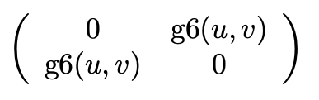
Formulation of Geodesic Deviation Equation
To visualise the nature of the singularity, we can work in a 2-Dimensional space (u, v).
The metric in this 2-Dimensional space corresponds to:
Using the following facts, we can approximate an expression for g₆
g_{6,v} diverges at v=0.
g₆ is analytic in nature
g₆ is continuous through v=0
g₆=a(u)+b(u)v^p ; where 0<p<1

Slide 30
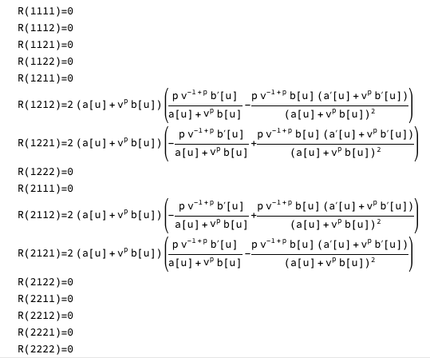
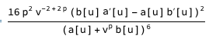
The Riemann tensor has 4-non zero components and only one independent component, Looking at the expression we see that, the curvature diverges at v = 0 as v^{p-1}.
Further, The Kretschmann Scalar also diverges at v = 0, but at the rate of v^{-2+2p} and has the form:

Slide 31
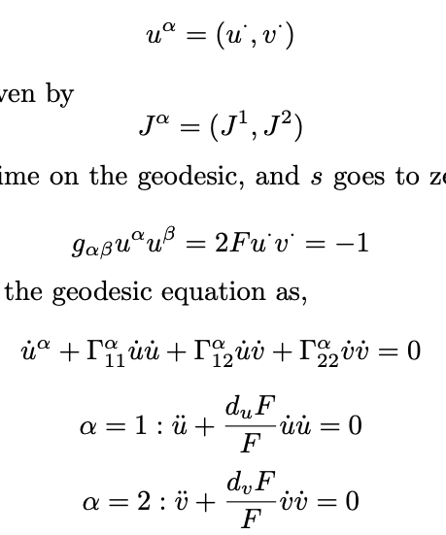
Consider a time-like geodesic approaching the null hypersurface v=0,The geodesic is parameterized by proper time s. Here, we will assume that as s approaches 0, v approaches 0 and u approaches u₀.
The tangent vector is given by,
The Jacobi field is given by,
Since, s is a proper time on the geodesic,
Further we can write the geodesic equation as,

Slide 32
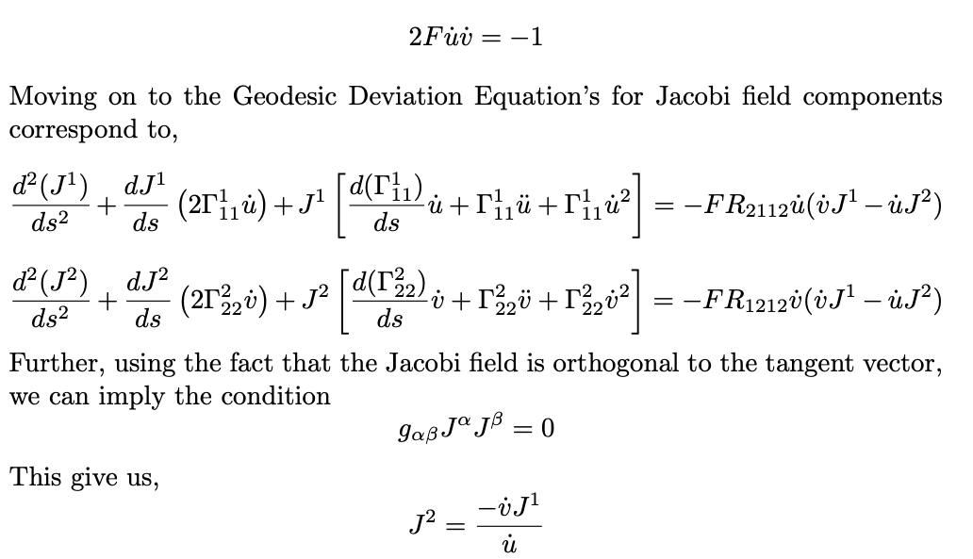
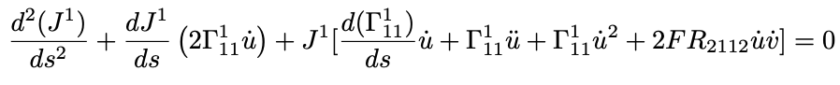
Moving on to the Geodesic Deviation Equations for Jacobi field components correspond to:
Further, using the fact that the Jacobi field is orthogonal to the tangent vector, we can imply the condition
This give us,
This helps us in getting rid of a system of two coupled 2nd order differential equations and obtain a single 2nd order differential equation. Simplifying, we get

Slide 33
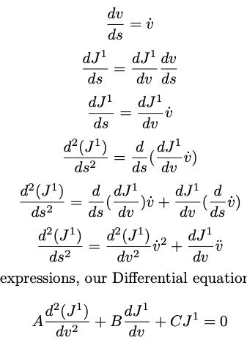
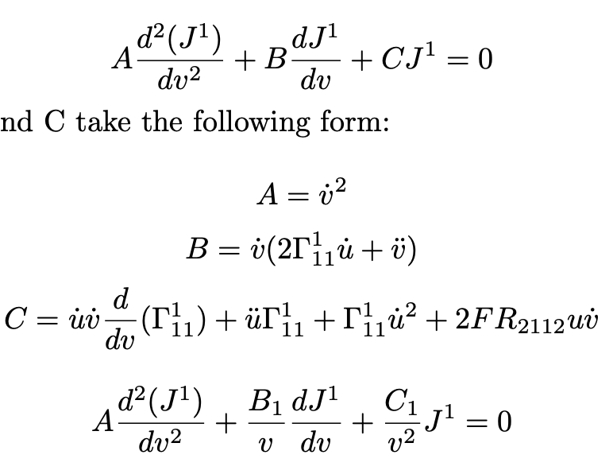
We now turn to change our independent variable to v, instead of s For that, we use
and
Using the above expressions, our Differential equation converts to
Where A,B and C take the following for

Slide 34
Our aim is to understand whether the singularity is weak or not, we can estimate that by assessing whether the geodesic deviation equations is consistent with finite and non-zero solutions of Jacobi field.
Looking at the form of equation,
Where,
Since B₁ and C₁ are analytic in nature and finite at zero, Frobenius method for second order differential equation implies that such an equation has a regular singular point at v = 0 and the solution can be expressed as a power series solution. Even if we don’t have the exact form of it, we know that the geodesic deviation equation is consistent with a finite and non zero Jacobi field form.This brings us to the conclusion that the singularity is weak and an observer falling into such a singularity might just survive it!

Slide 35
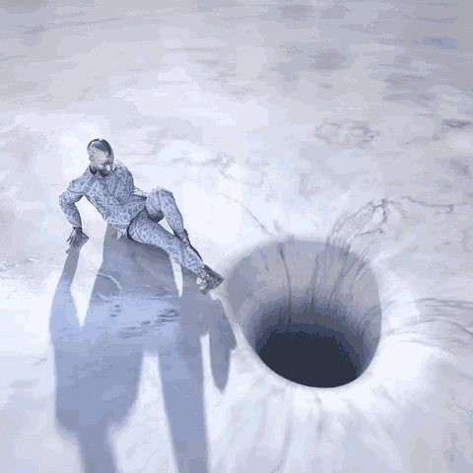
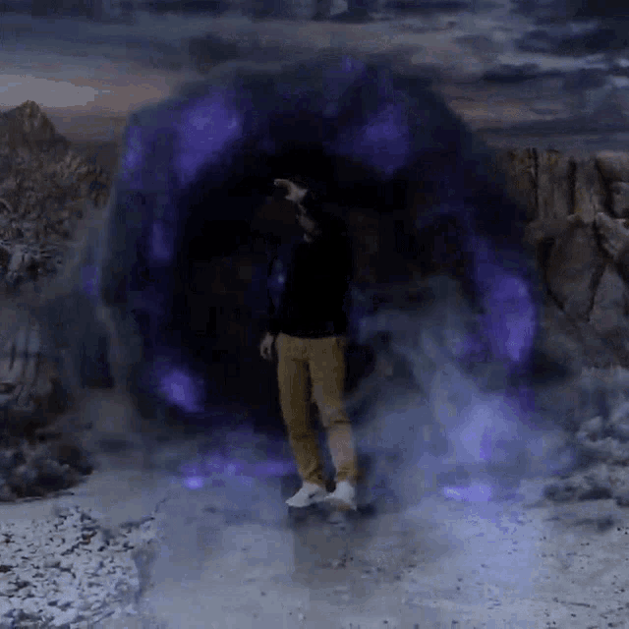
Conclusion
In short, you wouldn’t want to fall into a Schwarzschild Black hole!
In the first part,
The study finds out that an observer falling into a Schwarzschild Black hole would experience a process called Spaghettification which completely destroys the observer to net zero volume on it’s inevitable encounter with the singularity, deeming the Schwarzschild singularity to be strong and space-like.
In the second part,
The study through meticulous mathematical analysis fills in the claims used by Ori and Flanagan to show that Einstein field equations admits a generic class of solutions with a singularity across which the metric tensor remains continuous and well behaved. Further, The Geodesic deviation equation is assessed to conclude that it remains consistent with a finite and non-zero expression for the Jacobi fields, deeming the singularity to be null and weak curvature singularity.
Well, good news!!
You might just survive one such black hole!

Slide 36
Thank you for being a great listener!
Udai Sharma
( 22261555 )

